Slide 1
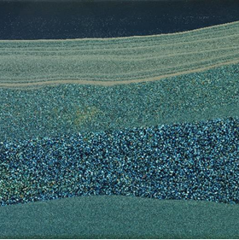
Institute for Modelling Hydraulic and Environmental Systems
Department of Hydromechanics and Modelling of Hydrosystems
FluidFlower Benchmark:
Community Simulation Results
Bernd Flemisch
26.04.2022

Slide 2
The participants
Group | Persons
Austin | Mohamad Jammoul, Mary Wheeler
CSIRO | Jonathan Ennis-King, Chris Green, James Gunning, Samuel Jackson, Andy Wilkins
Delft-DARSim | Hadi Hajibeygi, Yuhang Wang
Delft-DARTS | Denis Voskov, Michiel Wapperom
Heriot-Watt | Florian Doster, Sebastian Geiger
Imperial | Meissam Bahlali, Matthew Jackson, Carl Jacquemyn, Pablo Salinas
LANL | Bill Carey, Satish Karra, Hari Viswanathan
Melbourne | Stephan Matthai, Qi Shao, AbdAllah Youssef
Stanford | Jacques Franc, Hamdi Tchelepi
Stuttgart | Holger Class, Dennis Gläser, Fabian Jobst

Slide 3
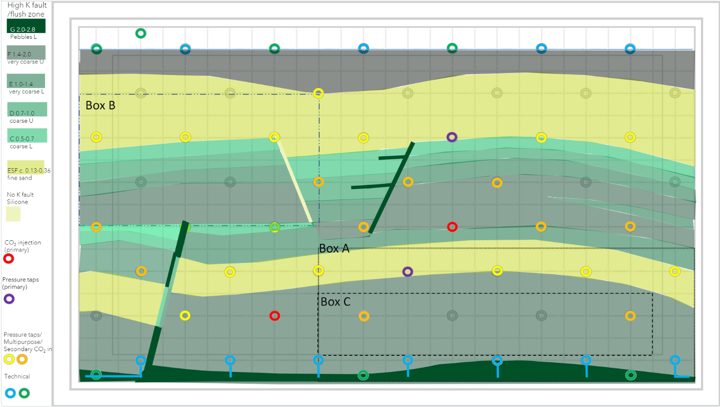
The intended geometry

Slide 4
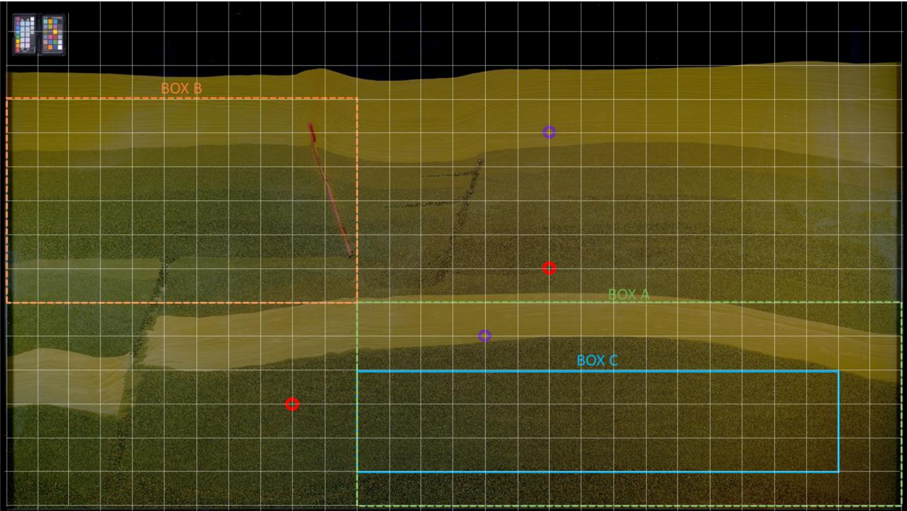
The implemented geometry

Slide 5
Reported Results Map of Phase Compositions
To be reported for each 24 hours after injection starts on a uniform Cartesian grid of 286 by 123 cells. For each temporal snapshot indicated by X hours, X = 24, 48, …, cell values should be provided in csv format in a file spatial_map_<X>h.csv of the form
# x, y, saturation [-], concentration [kg/m3] 5.000e-03, 5.000e-03, 1.234e+56, 1.234e+56 1.500e-02, 5.000e-03, 1.234e+56, 1.234e+56 … 2.855e+00, 5.000e-03, 1.234e+56, 1.234e+56 5.000e-03, 1.500e-02, 1.234e+56, 1.234e+56 1.500e-02, 1.500e-02, 1.234e+56, 1.234e+56 … … 2.845e+00, 1.225e+00, 1.234e+56, 1.234e+56 2.855e+00, 1.225e+00, 1.234e+56, 1.234e+56
The origin of the coordinate system should be located in the lower left corner with the x-axis positively oriented towards the right and the y-axis positively oriented towards the top.

Slide 6
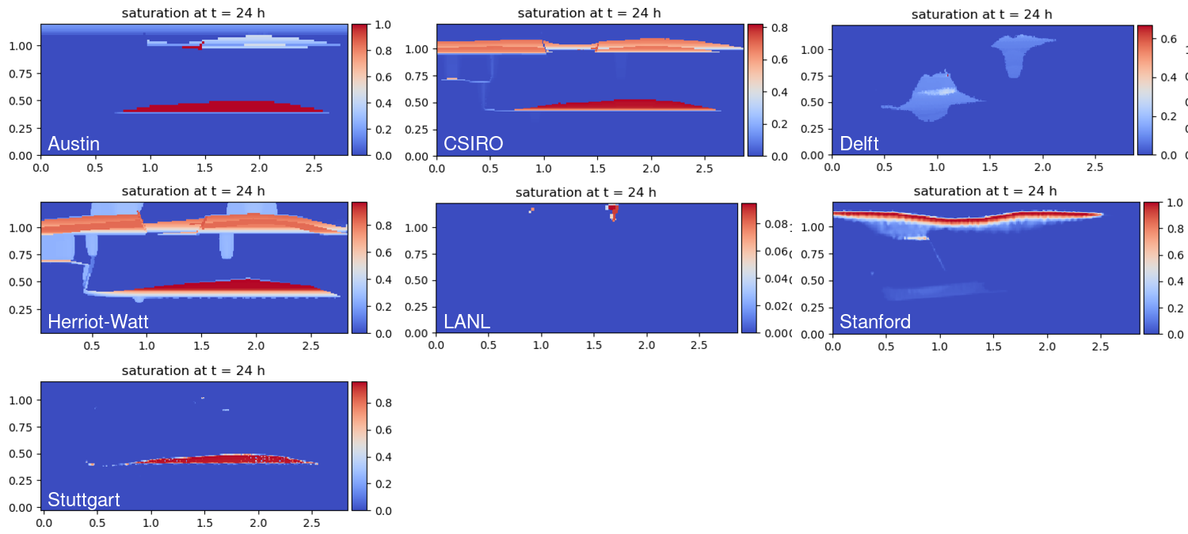
Spatial Maps: Saturation at t = 24 h
Back in January!

Slide 7
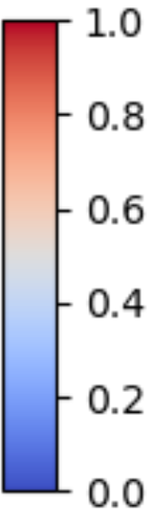
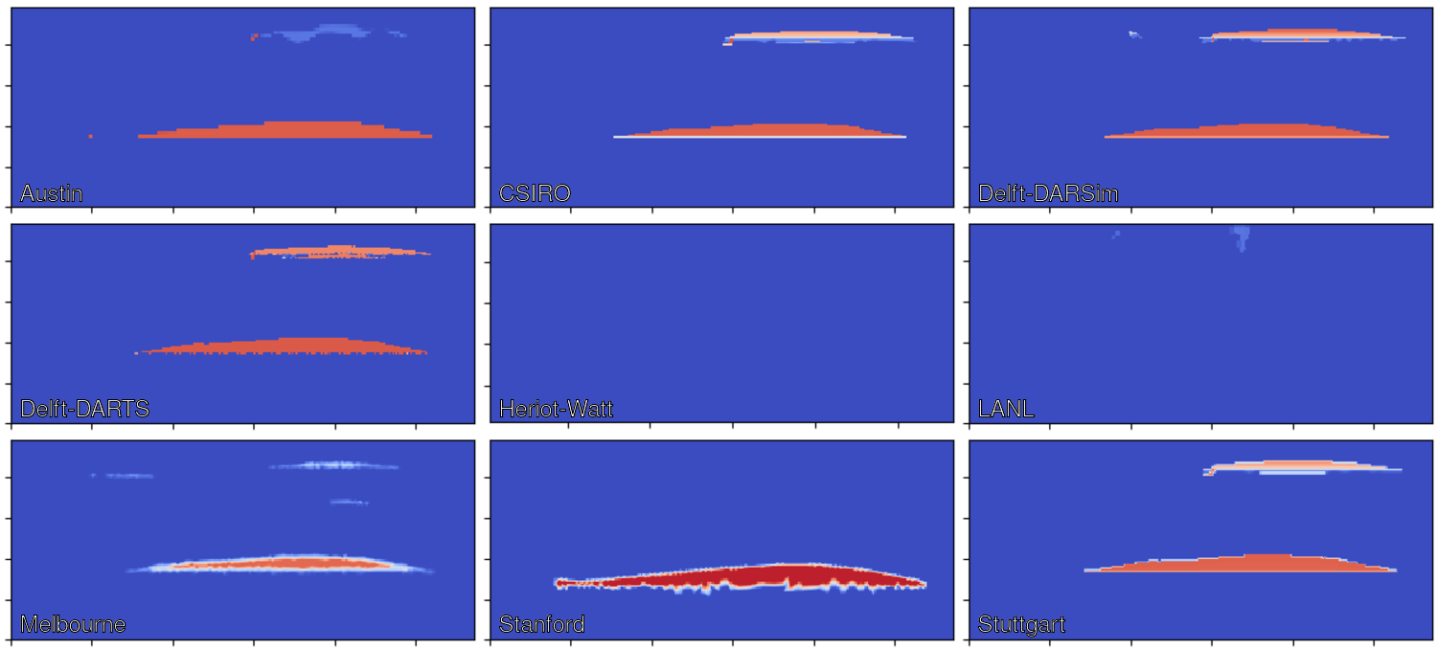
Spatial Maps: Saturation [-] at t = 24 h

Slide 8
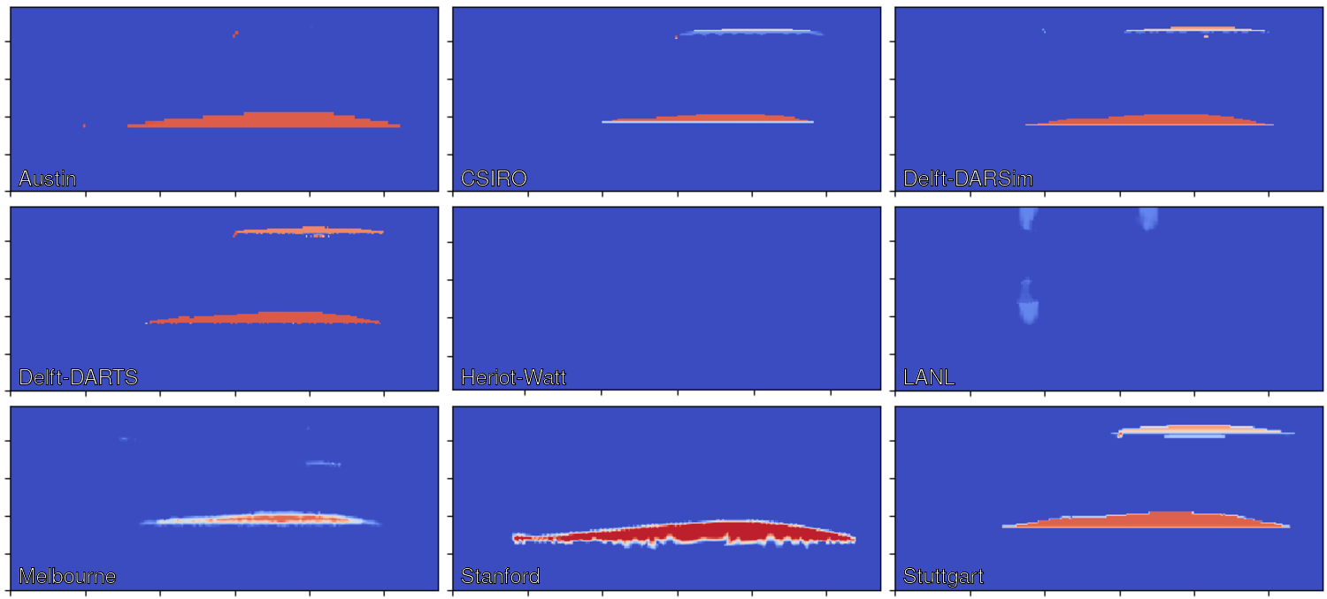
Spatial Maps: Saturation [-] at t = 48 h

Slide 9
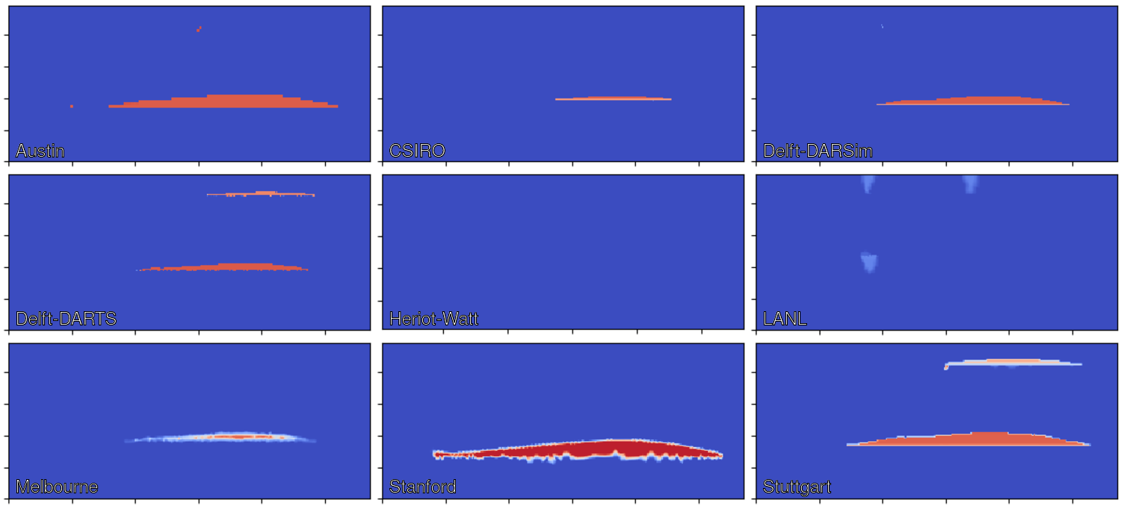
Spatial Maps: Saturation [-] at t = 72 h

Slide 10
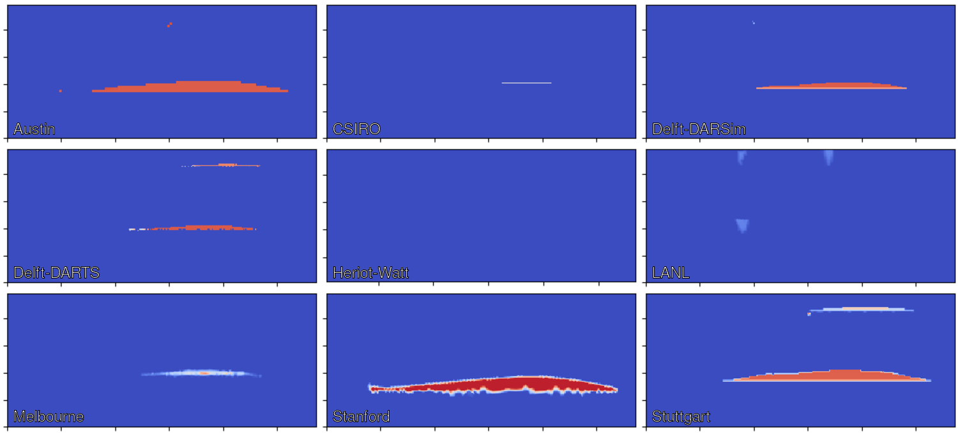
Spatial Maps: Saturation [-] at t = 96 h

Slide 11
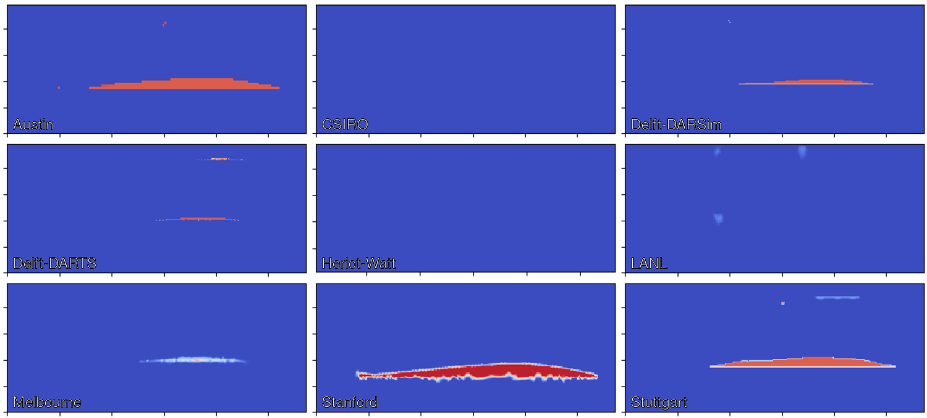
Spatial Maps: Saturation [-] at t = 120 h

Slide 12
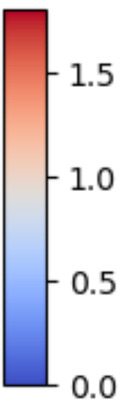
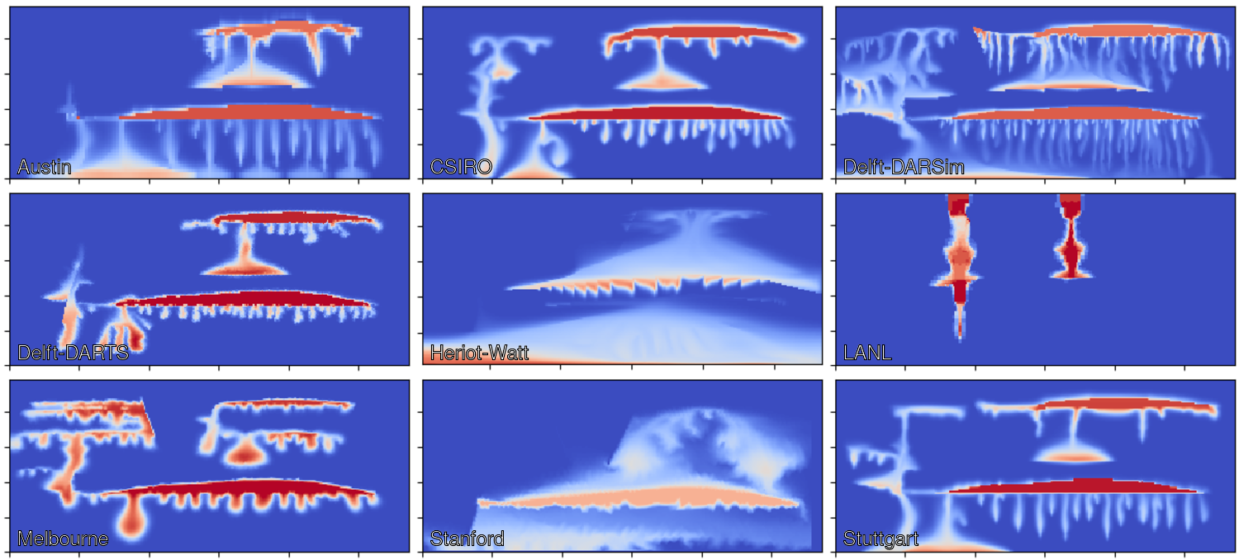
Spatial Maps: Concentration [kg/m³] at t = 24 h

Slide 13
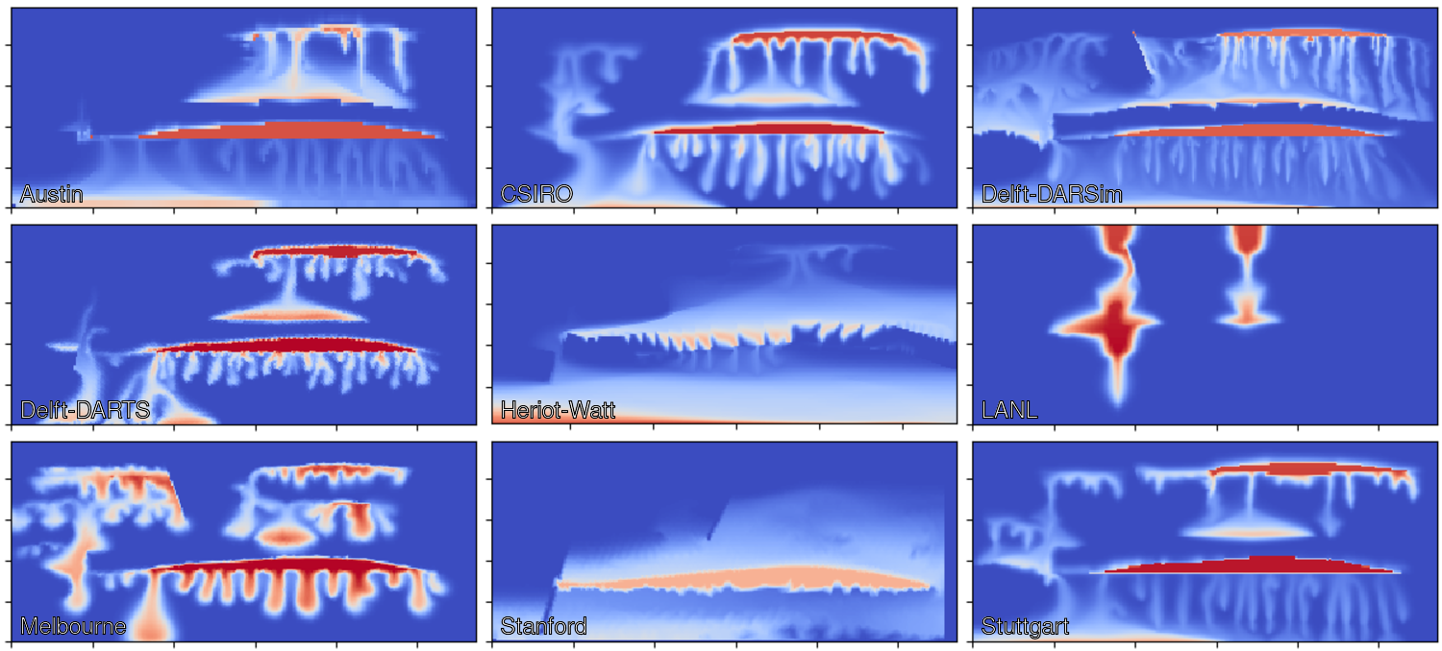
Spatial Maps: Concentration [kg/m³] at t = 48 h

Slide 14
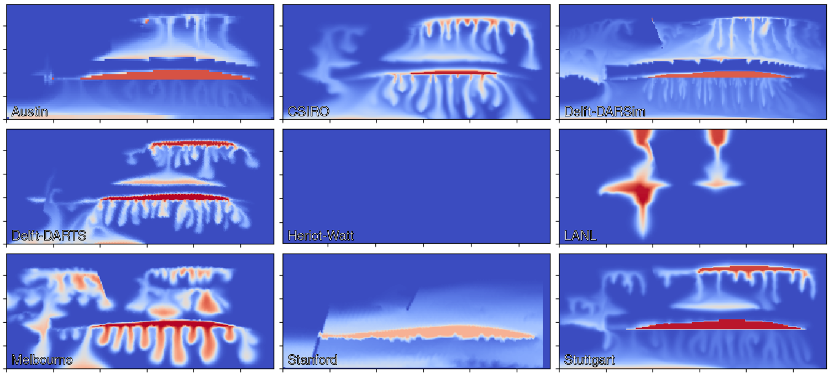
Spatial Maps: Concentration [kg/m³] at t = 72 h

Slide 15
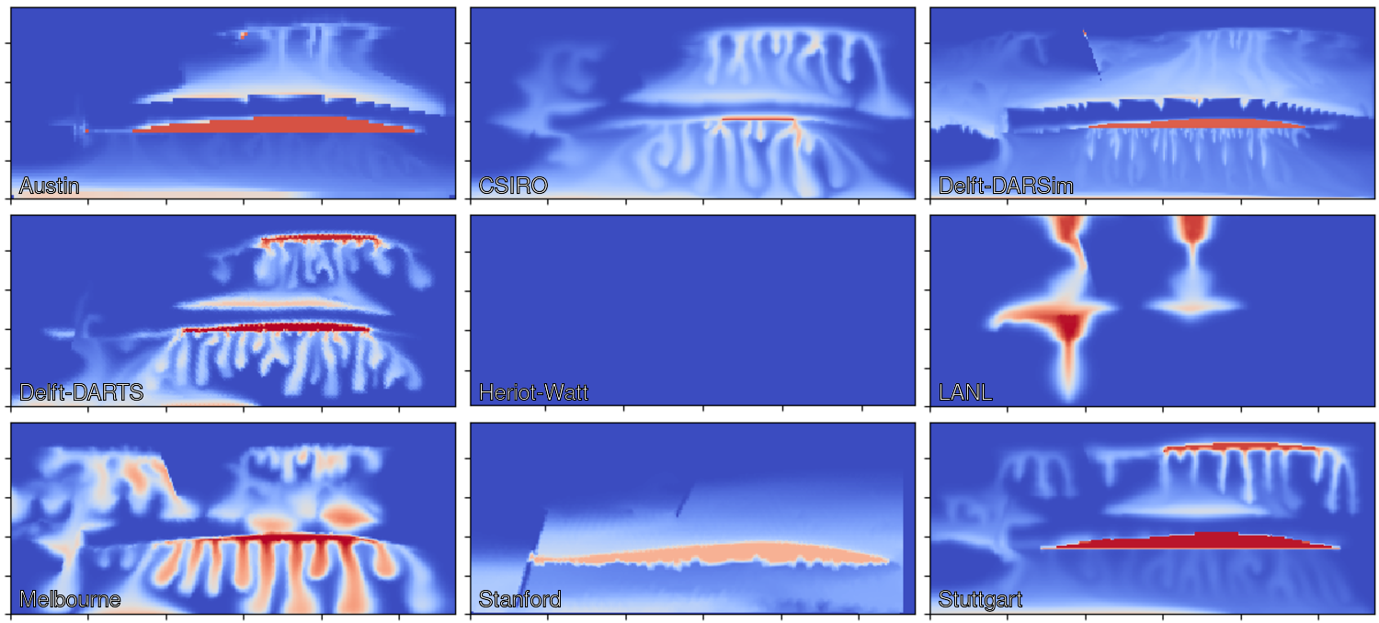
Spatial Maps: Concentration [kg/m³] at t = 96 h

Slide 16
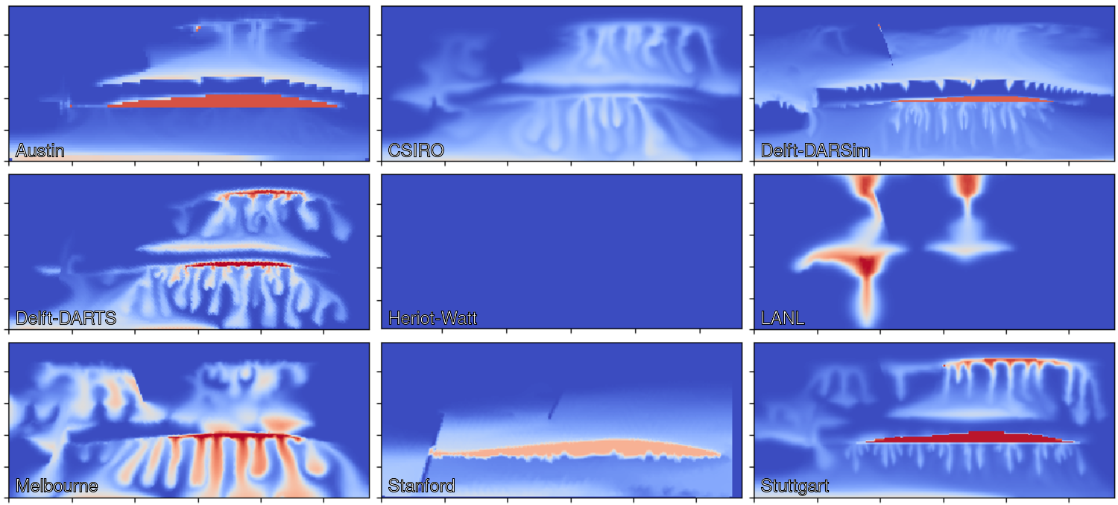
Spatial Maps: Concentration [kg/m³] at t = 120 h

Slide 17
Reported Results Dense Data Time Series
All measurables identified in section 2.7 shall be reported at 10-minute intervals starting at the initial injection and lasting 120 hours. The data is expected in csv format in a file time_series.csv of the form
# t, p_1, …, totalCO2Mass 0.000e+00, 1.234e+56, 1.234e+56, <…> 6.000e+02, 1.234e+56, 1.234e+56, <…> ...
according to the measurables defined in section 2.7.

Slide 18
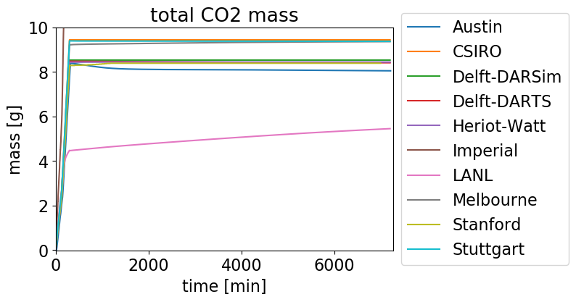
Time Series: Total CO2 Mass

Slide 19
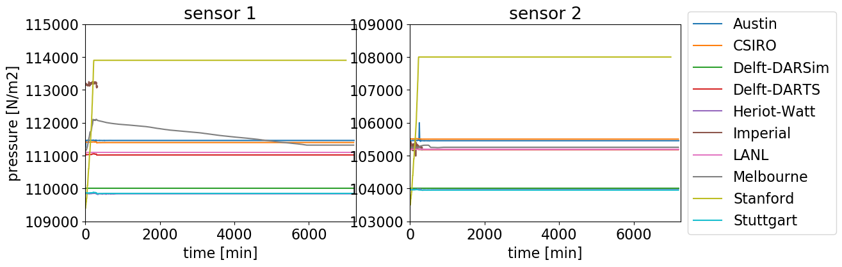
Time Series: Pressure

Slide 20
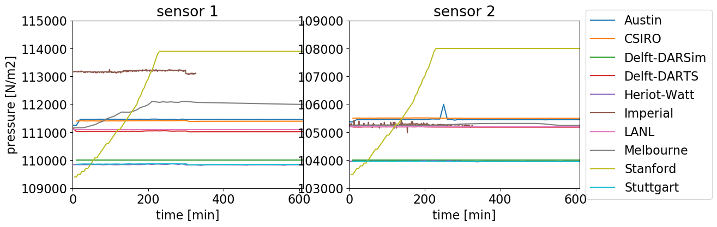
Time Series: Pressure Zoom into Time

Slide 21
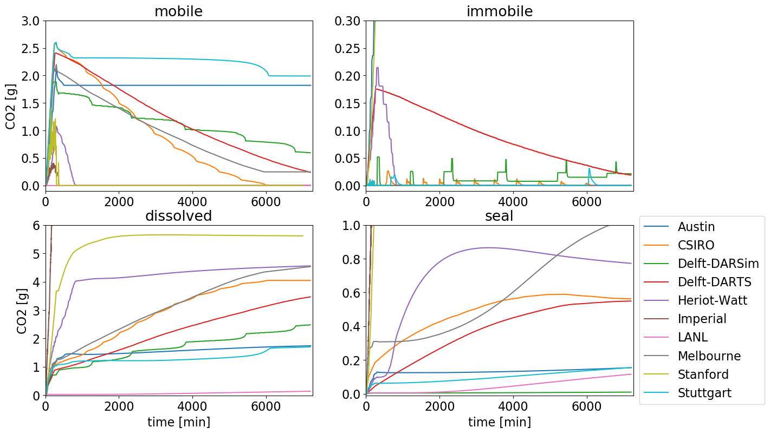
Time Series: Box A

Slide 22
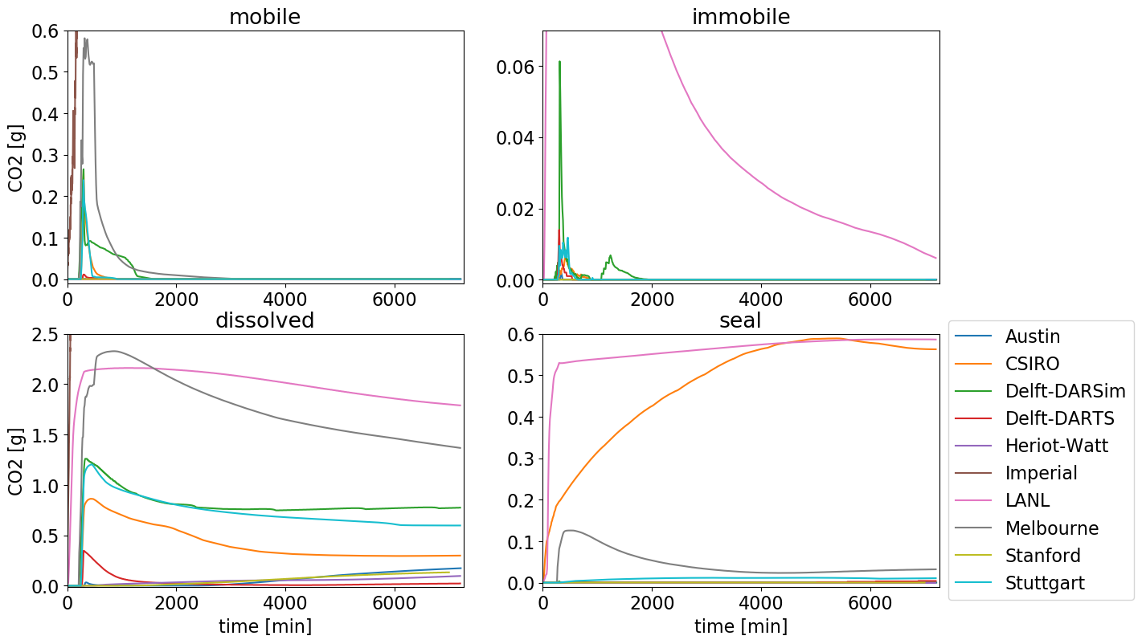
Time Series: Box B

Slide 23
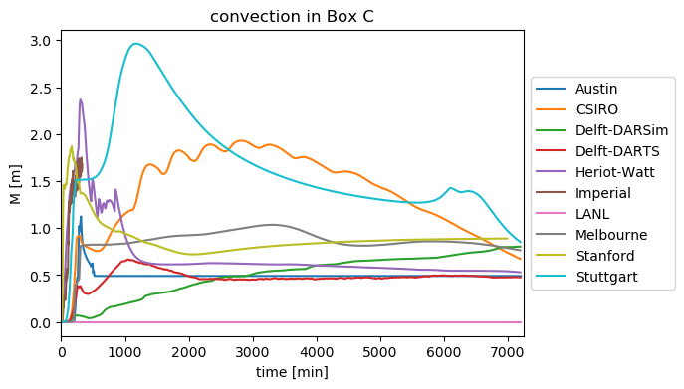
Time Series: Box C

Slide 24
Reported Results Sparse Data Determination
Each of the sparse data shall be reported as six numbers:
Prediction of the mean quantity as obtained by the experiments
Prediction in the standard deviation of the quantity over the ensemble of experiments
Stated in terms of P10, P50 and P90 values
Mean values assess the capability of predicting the various measurables
Standard deviations address the extent to which these quantities are deterministic
Any preferred methodology may be chosen:
ensemble runs
methods from uncertainty quantification
human intuition from experience

Slide 25
Reported Results Sparse Data Format
The quantities are expected to be uploaded to the repository in form of a csv file sparse_data.csv of the form
# idx, p10_mean, p50_mean, p90_mean, p10_dev, p50_dev, p90_dev 1a, 1.234e+56, <…>, # pressure at sensor 1 [N/m2] 1b, 1.234e+56, <…>, # pressure at sensor 2 [N/m2] 2, 1.234e+56, <…>, # time of max mobile free phase in Box A [s] 3a, 1.234e+56, <…>, # mobile free phase in Box A at 72h [kg/m2] 3b, 1.234e+56, <…>, # immobile free phase in Box A at 72h [kg/m2] 3c, 1.234e+56, <…>, # dissolved in water in Box A at 72h [kg/m2] 3d, 1.234e+56, <…>, # seal in Box A at 72h [kg/m2] 4a-d <same for Box B> 5, 1.234e+56, <…>, # time when M exceeds 110% of Box C’s width [s] 6, 1.234e+56, <…>, # total mass of CO2 in the top seal facies [kg]

Slide 26
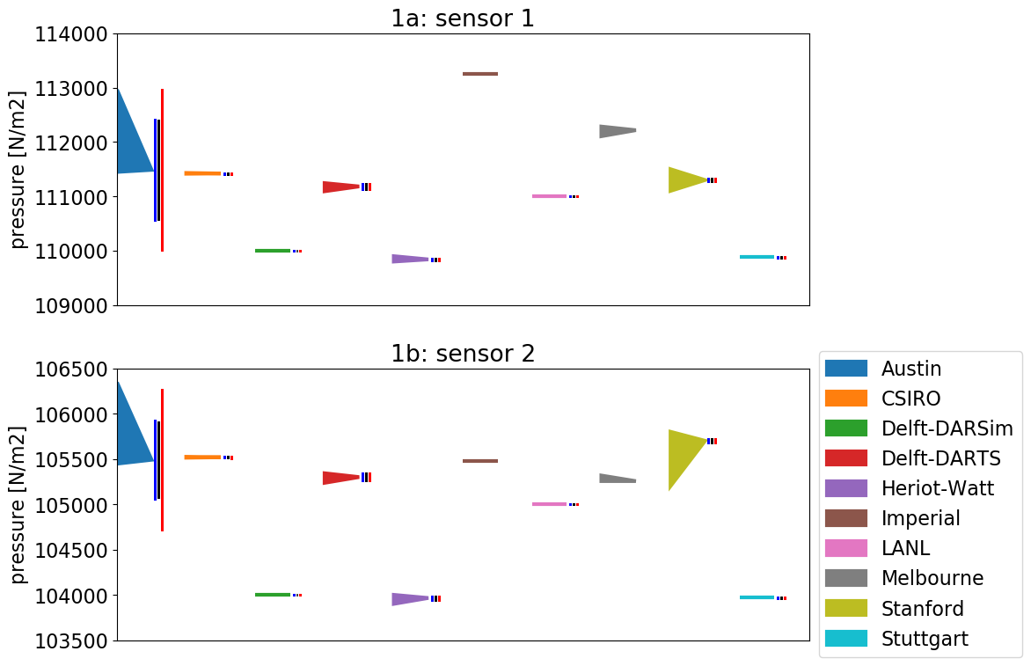
Sparse Data: Pressure

Slide 27
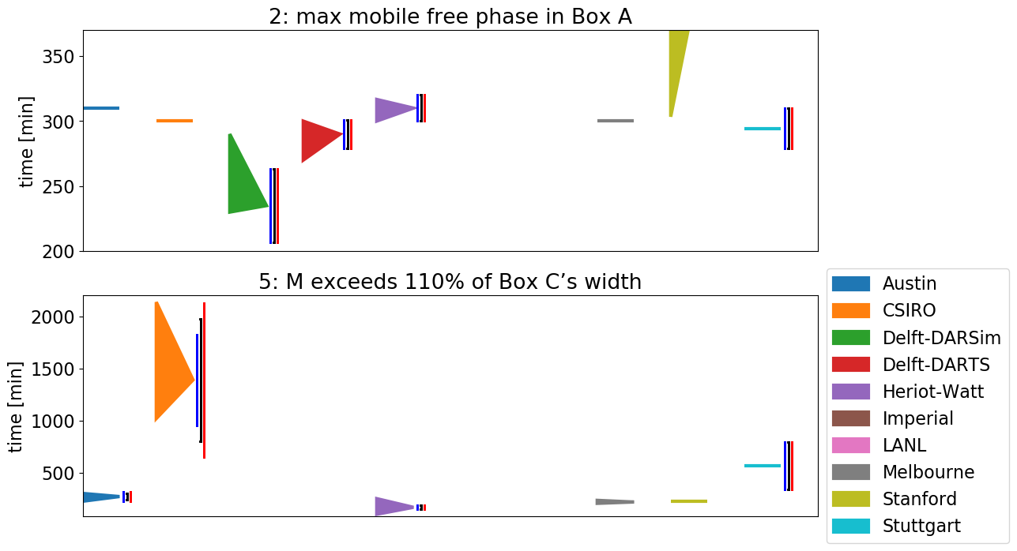
Sparse Data: Time

Slide 28
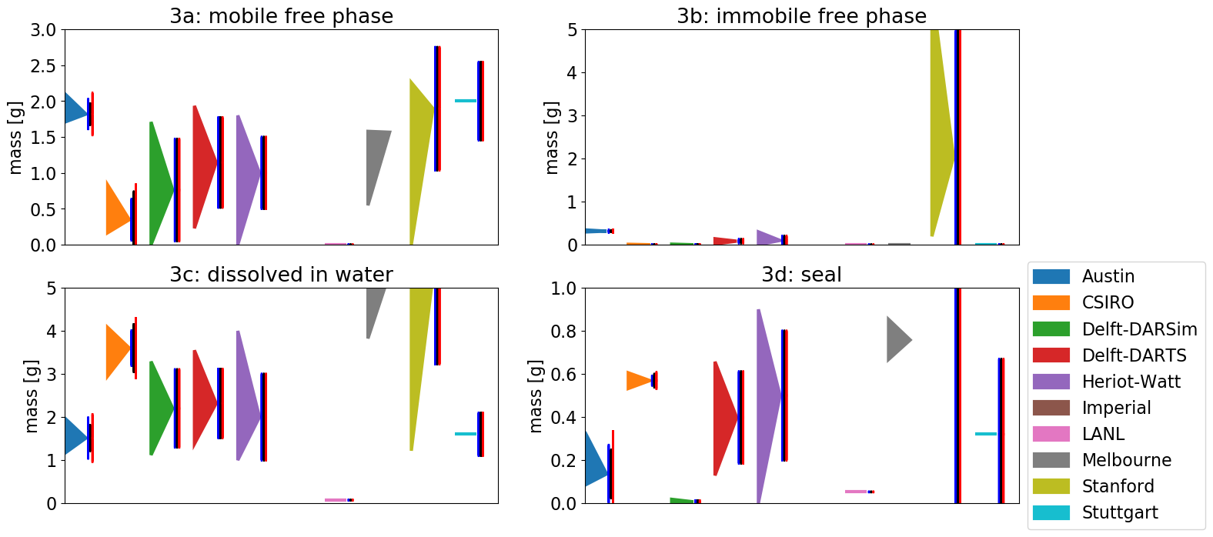
Sparse Data: CO2 in Box A at 72 h

Slide 29
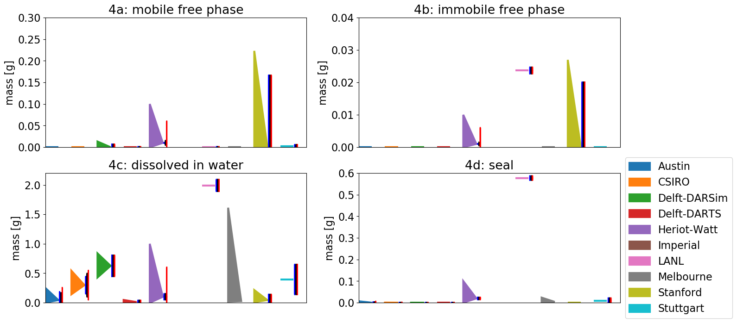
Sparse Data: CO2 in Box B at 72 h

Slide 30
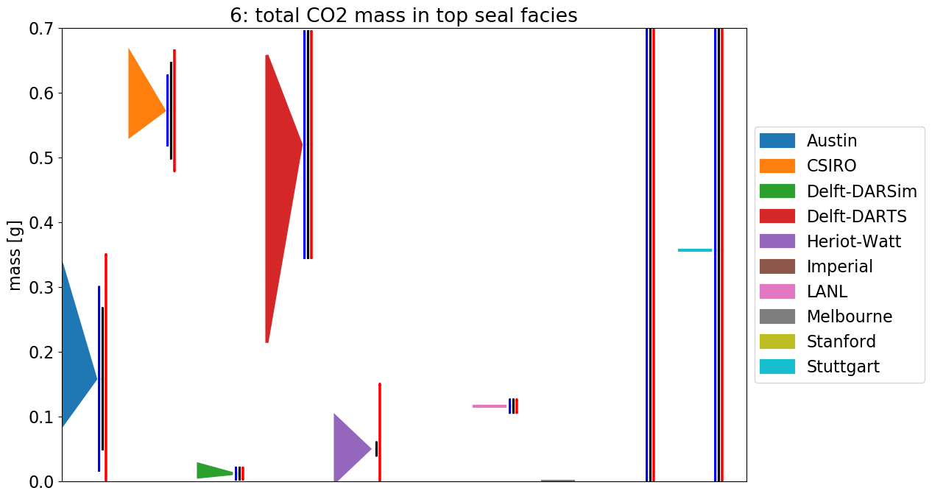
Sparse Data: Total CO2 mass in top seal facies

Slide 31
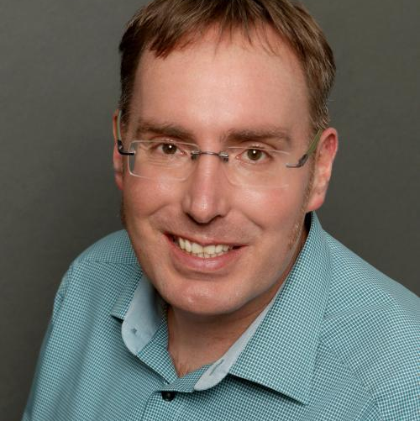
Institut für Wasser- und Umweltsystemmodellierung Lehrstuhl für Hydromechanik und Hydrosystemmodellierung
Bernd Flemisch
E-Mail
bernd@iws.uni-stuttgart.de
Telefon +49 (0) 711 685-
69162
www.
iws.uni-stuttgart.de/lh2
Universität Stuttgart
IWS-LH2
Pfaffenwaldring 61, 70569 Stuttgart

Slide 32
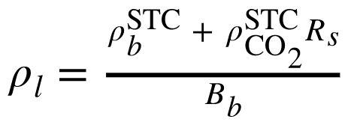
Modeling Choices
Type | Austin | CSIRO | Delft-DARSim | Delft-DARTS | Imperial | LANL | Melbourne | Stanford | Stuttgart
PDEs | CMB | CMB | CMB | CMB | PMB + CO2-dissolved transport | CMB | PMB + CO2-dissolved transport | Pseudo Black Oil | CMB
pc, relperm | BC | BC | BC | const. pEntry, power law | const. pEntry, power law | Linear | BC | BC pc, linear + quad. relperm | BC
EOS | PR | Spycher fugacity-based | Spycher et al. (2003) | constant K-values | n/a | Duan & Sun |  | Weiss, Sandve et al., Duan & Sun | Spycher & Pruess, Duan & Sun, Spycher, Pruess & Ennis-King
density |  | IAPWS + Garcia, Span & Wagner | Redlich-Kwong EOS | (1002 + x_CO2 * 320) * (1 + 1e-6 * (p - 1)), 2 * (1 + 1e-4 * (p - 1)) |  | Span & Wagner |  | Phillips et al., Fenghour & Wakeham, Span & Wagner | IAPWS, Span & Wagner
Coupling | FC, FI, vel.-enhanced MFEM | FC, FI, cell-centered FV | FC, FI, cell-centered FV | FC, FI, cell-centered FV | FC, FI, double CV FEM | FC, FI, cell-centered FV | FC, FI, cell-centered FV | FI, cell-centered FV | FC, FI, cell-centered FV
Solvers | GMRES-AMG | Newton-LS, GMRES-ASM | Direct linear | Newton-Chop, GMRES-CPR | Anderson, GMRES-HYPRE | Newton, FGMRES-CPR | Newton-LS | Direct linear | Newton-LS, direct linear
32

Slide 33
Modeling Choices, Discretization and Performance
Type | CSIRO | Delft-DARSim | Delft-DARTS | Herriot-Watt | Imperial | LANL | Stanford | Stuttgart
Solubility limit [kg/m³] | 1.786 | 1.649 | 1.90 | 2.0 | 1.504 | 1.67 | 1.5 | 1.845
Temperature [°C] | 20.0 | 20.0 | 20.0 | 20.0 | 20.0 | 20.0 | 20.0 | 20.0
Domain volume [m³] | 0.0865 | 0.083 | 0.092 | 0.084 | 0.088 | 0.0818 | 0.084 | 0.0875
Cells | 44,284 | 43,758 | 48,274 | 42,000 | 4,437 – 30,784 | 24,748 | 6,094 / 21,392 | 26,099
Avg. Δt [s] | 1.96 / 35.9 | 13.1 / 79.8 | 14.0 | 100.0 | 0.16 | 6.0 | 2.28 | 20.44
Avg. nonlin. it. per time step | 3.0 / 3.0 | 1.3 / 1.0 | 1.4 | 10.0 | 9.9 | 1.0 | 1.07 | 7.3

Slide 34
Sparse Data: Austin

Slide 35
Sparse Data: CSIRO

Slide 36
Sparse Data: Delft-DARSim

Slide 37
Sparse Data: Delft-DARTS

Slide 38
Sparse Data: Heriot-Watt

Slide 39
Sparse Data: Imperial

Slide 40
Sparse Data: LANL

Slide 41
Sparse Data: Melbourne

Slide 42
Sparse Data: Stanford

Slide 43
Sparse Data: Stuttgart

